Slide 1


Microsoft SharePoint
mintesnot

Slide 2

What is Visualization in Power BI?
Benefits of Visualization
Bar Charts
Column Charts
Line Charts
Line & Stacked Column Chart
Area Charts
Pie Charts
Donut Charts
Tree Map
Scatter Plot
Map Charts

Slide 3

What is Visualization in Power BI?
Visualization in Power BI refers to the graphical representation of data through various types of charts, graphs, and other visual elements.
The primary goal of visualization is to provide a clear and intuitive way to understand complex data.
Enables users to identify trends, patterns, and insights quickly.

Slide 4

Benefits of Visualization in Power BI
Enhanced Understanding: Visuals make complex data more accessible & understandable.
Quick Insights: Users can quickly grasp key metrics and performance indicators at a glance.
Real-Time Monitoring (Dashboard): Act like a dashboard in a car, providing real-time updates on key metrics.

Slide 5
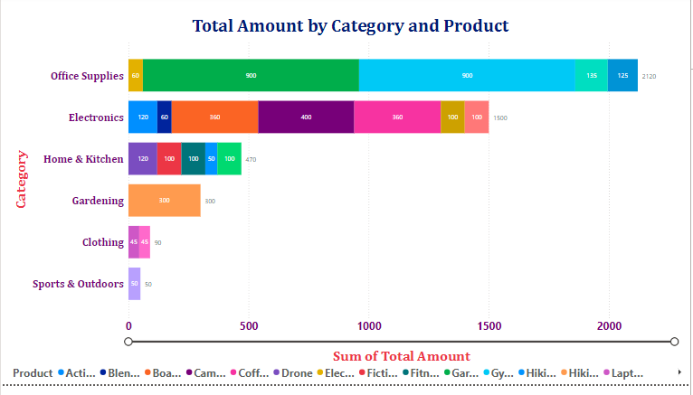
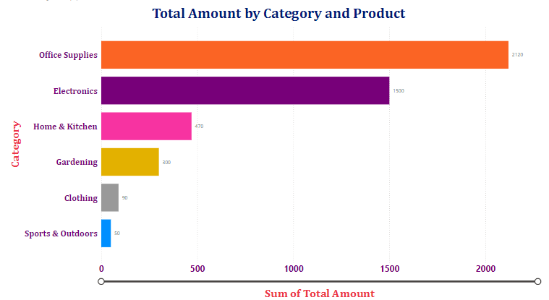
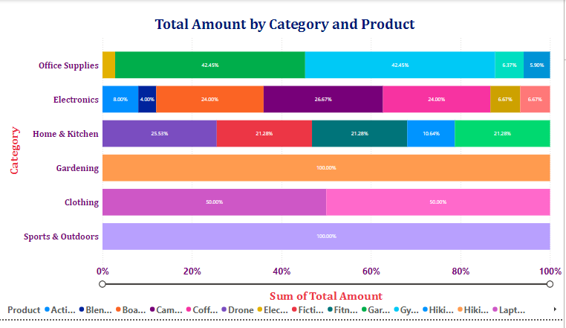

Bar Charts
A Bar chart displays data using horizontal bars.
Length of the bar represents the value.
Categories are listed on the vertical axis.
Three types: Clustered, Stacked & 100% Stacked.
Use Cases:
Compare many categories easily.
Display long category names clearly.
Rank data (highest to lowest).
Best for large data sets & Categorical comparisons.
Stacked
Clustered
100% Stacked

Slide 6
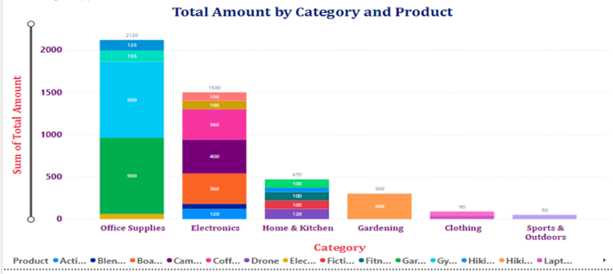
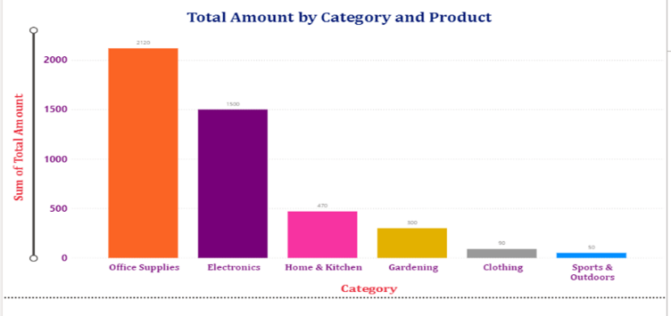
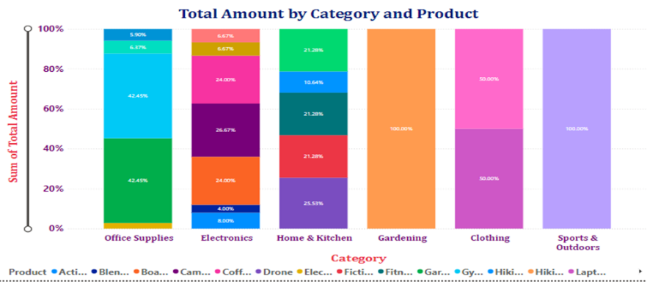

Column Charts
A Column chart displays data using vertical bars.
Each column represents a category.
The height of the column shows the value.
Three types: Clustered, Stacked & 100% Stacked.
Use Cases:
Compare values across categories.
Show changes over time (e.g., monthly sales).
Highlight trends clearly.
Best for time-based data, small to medium number of categories.
Stacked
Clustered
100% Stacked

Slide 7
Column Chart Vs Bar Chart
Feature | Column Chart | Bar Chart
Orientation | Vertical | Horizontal
Best Use | Time trends | Category comparison
Space Usage | Needs more width | Needs more height
Labels | Short labels | Long labels

Slide 8
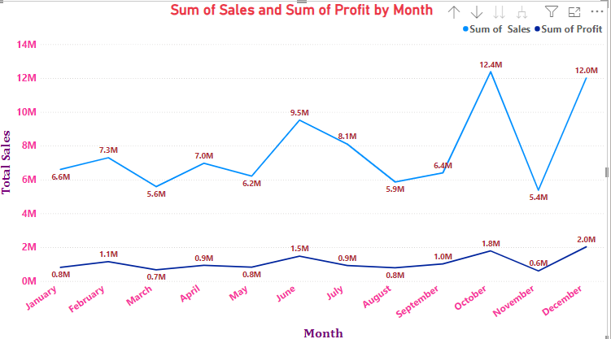
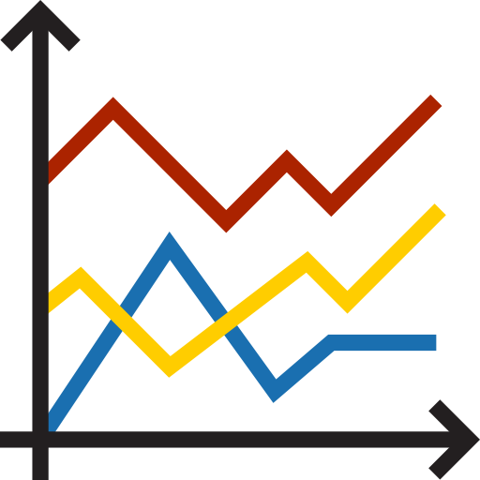
Line Charts
Line Charts are used to display data trends over time.
Data points are connected by a continuous line.
Shows information as a series of data points.
Typically used for time-series data.
Use Cases:
Shows trends over time.
Track performance (sales, revenue, growth).
Compare multiple variables.
Identify patterns & seasonality.
Best for continuous data, time-based analysis.

Slide 9
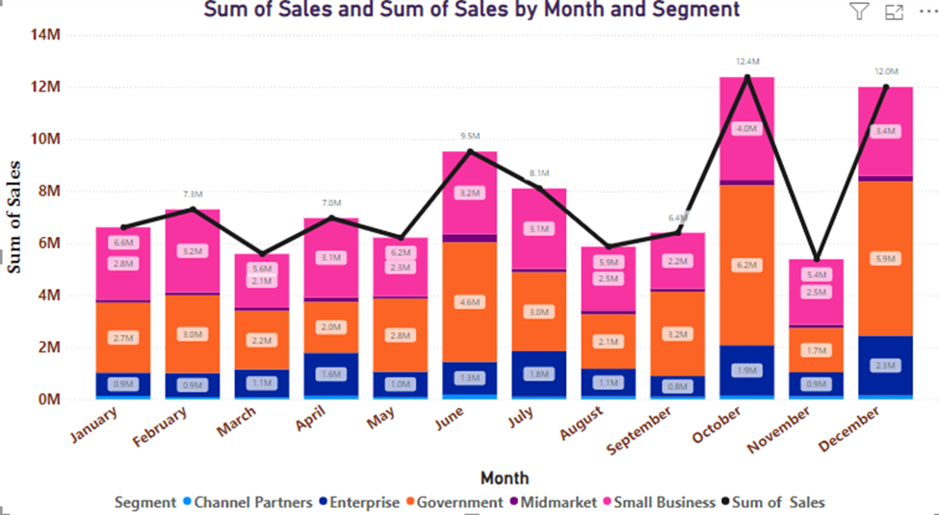
Line & Stacked Column Charts
Line & Stacked Column Chart combines line chart & a stacked column chart.
Allows to analyze trends over time while also observing the composition of different categories.
Use Cases:
Combines multiple insights in one chart
Saves dashboard space.
Shows relationships between metrics.
Compare total vs breakdown.
Show trend + composition together.
Analyze performance across categories over time.

Slide 10
… Comparison with Other Charts
Chart Type | Purpose
Column Chart | Simple Comparison
Line Chart | Trend over time
Stacked Column Chart | Composition
Line & Stacked Column | Trend + Composition together

Slide 11
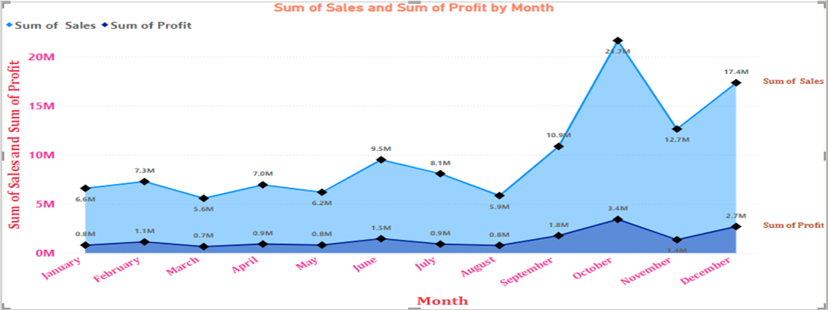

Area Charts
Area Charts are like line charts but with the area filled below the line.
Used to show trends over time along with magnitude. (Highlights trend & quantity).
Helps emphasize the volume of data.
Use Cases:
Show trends over time.
Display cumulative totals.
Compare multiple data series.
Emphasize the magnitude of values.
Best for time-based data, showing contribution to total.

Slide 12
Area Chart Vs Line Chart
Feature | Area Chart | Line Chart
Fill | Colored Area | No Fill
Focus | Trend + Volume | Trend only
Best Use | Cumulative data | Precise trends
Visual Impact | More attractive | Simpler

Slide 13
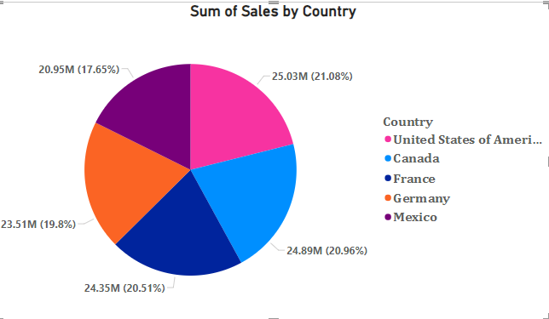

Pie Chart
Pie Chart is a circular chart divided into slices.
Each slice represents a proportion of the total. (Total equals 100%).
Use Cases:
Show percentage distribution.
Compare parts of a whole.
Highlight dominant categories.
Best for Small number of categories (5-6 max & Simple datasets).

Slide 14
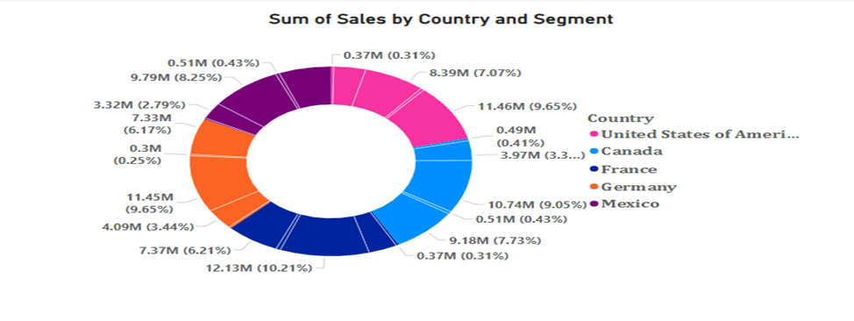

Donut Chart
Donut Chart is like pie chart but with a hole in the center.
Displays proportions in a circular format.
Center space can show additional information.
Use Cases:
Show proportion of categories.
Display summary values in the center.
Improve visual design in dashboards.
Best for Dashboard visuals, Highlighting key metrics.

Slide 15
Pie Chart Vs Donut Chart
Feature | Pie Chart | Donut Chart
Shape | Full Circle | Circle with hold
Center Space | Not available | Available
Best Use | Cumulative data | Precise trends
Visual Impact | More attractive | Simpler

Slide 16
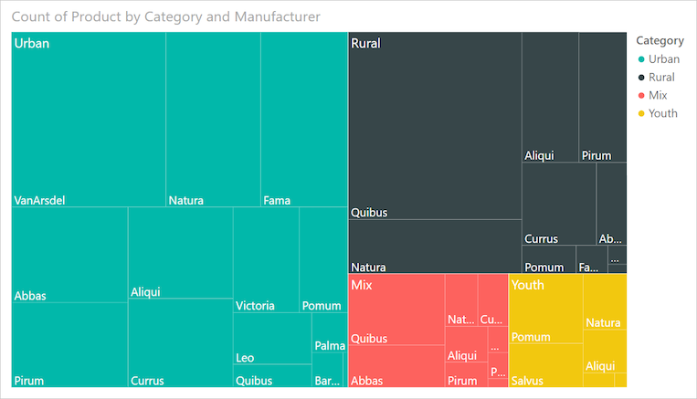

Tree Map
Tree Map displays data as nested rectangles.
Each rectangle represents a category.
Size of the rectangle shows the value.
Use Cases:
Show hierarchical data.
Display many categories at one & efficient use of space.
Compare proportions within categories.
Identify largest and smallest contributors.
Best for Part-to-whole relationships, large datasets with hierarchy.

Slide 17
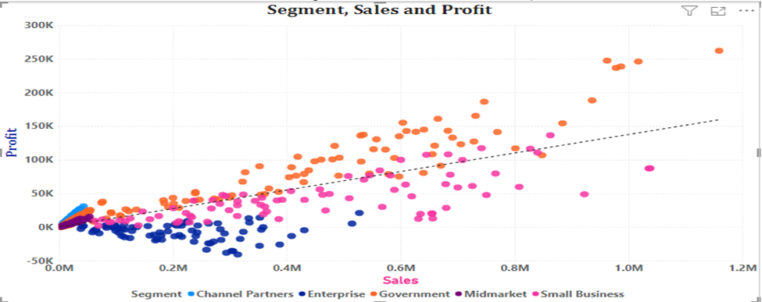
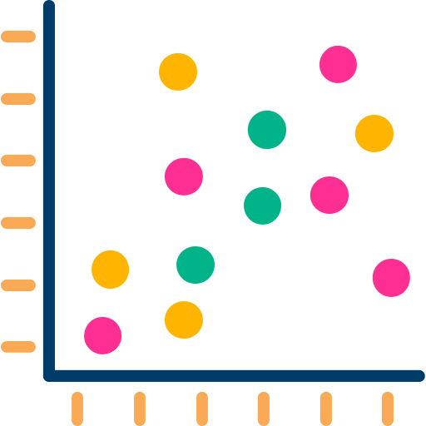
Scatter Plot
Scatter Plot shows data as points on a graph.
Used to display relationship between two variables.
Each point represents a data record.
Use Cases:
Identity relationships or correlations.
Detect patterns and trends.
Spot outliers.
Supports multiple variables.
Helps in predictive analysis.
Best for Numerical data, Statistical Analysis.

Slide 18
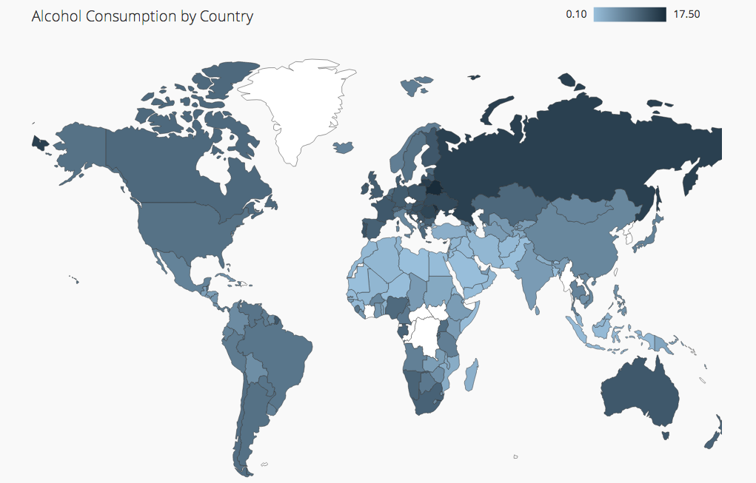

Map Charts
Map Charts display data based on geographic locations.
Helps users understand spatial patterns & trends.
Widely used in business, logistics, and analytics.
It is a visual representation of data on a map based on Country, City, Region, Latitude & Longitude.
Use Cases:
Analyze geographic trends.
Track regional performance.
Identify high & low-performing areas.
Support decision-making based on locations.

Slide 19
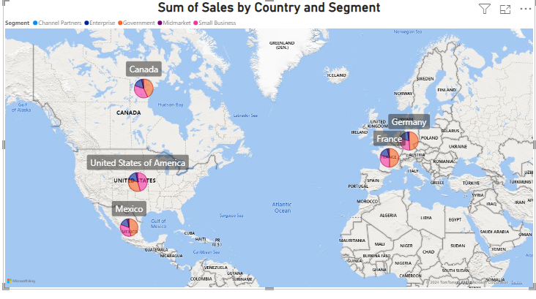
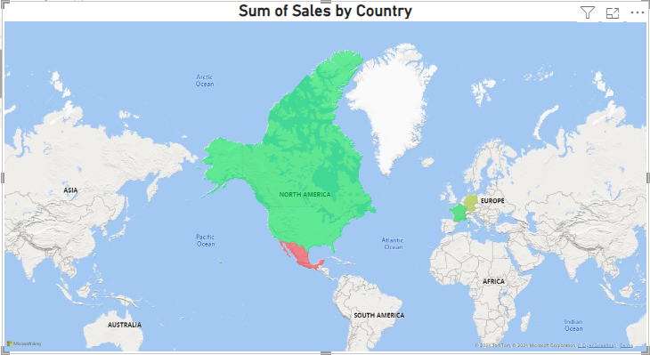
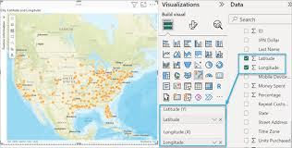
… Types of Maps in Power BI
Basic Maps: Displays data points on a standard map.
Filled Maps: Colors geographic areas based on a value (e.g., sales by state).
ArcGIS Maps: Offers advanced mapping capabilities, including layers and spatial analytics.
Basic Map
Filled Map
ArcGIS Map

Slide 20
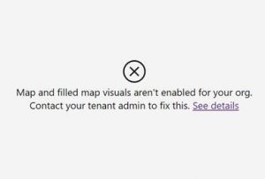
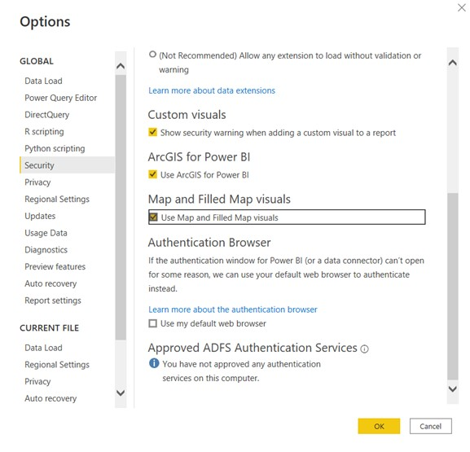

… Enable Map Charts
Map Visuals are NOT enabled by default in Power BI.
✅ How to Enable Map Charts
Open Power BI Desktop
Go to File → Options and Settings → Options
Select Security (or Global → Security)
Enable:
✔ Use Map and Filled Map visuals
✔ Use ArcGIS for Power BI
Click OK and restart Power BI if needed
NOT enabled warning
ENABLE in the settings

